Slide 1
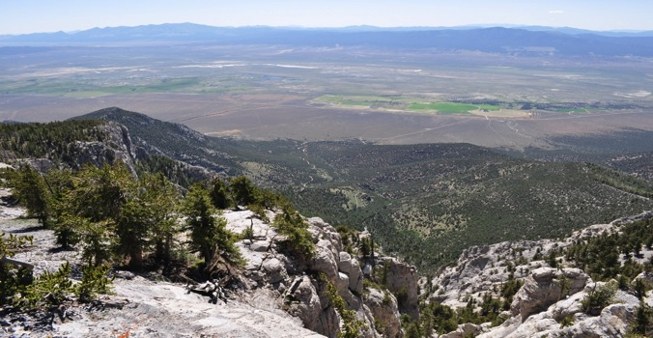
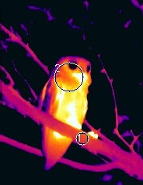
Desert Birds in a Warming World: Characterizing Thermal Stress with Daily Earth Observation Data in Complex Terrain and Microsites
Thomas P. Albright
Laboratory for Conservation Biogeography
Department of Geography
Mackay School of Earth Science & Engineering
& Program in Ecology, Evolution, and Conservation Biology
University of Nevada, Reno
NASA Biodiversity & Ecological Forecasting Science Team, College Park, MD 22-23 April 2015

Slide 2
Warmer temps…
More extremes…
J. Hansen et al., PNAS 103: 14288-293 (2006)
[Coumou & Rahmstorf, Nature Climate Change, 2012]
Notes:
Make this graphical rather than linear.

Slide 3
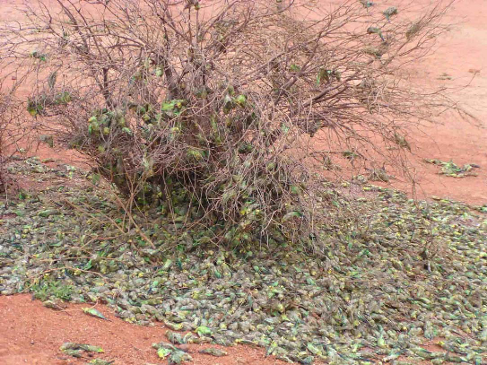
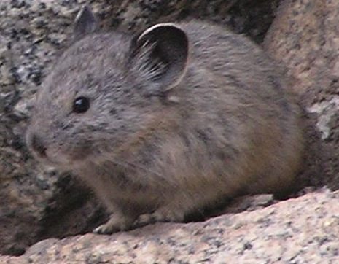
Direct and indirect effects on fauna…
[Northern Guardian (Australia)]
Ground-nesting bird
response to nominal
100-year heat event
[Albright et al., 2010 Ecosphere]
Notes:
Make this graphical rather than linear.

Slide 4
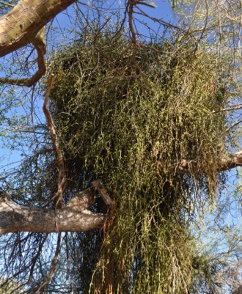
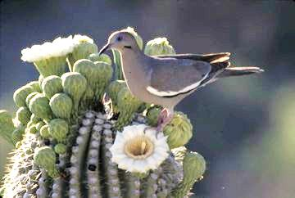
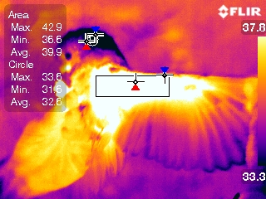
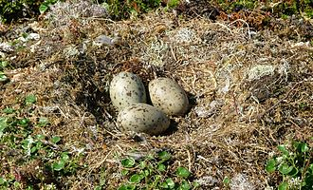
And yet…
[T. Albright]
Temperature extremes are highly variable in space and time at multiple scales
Animals vary greatly in ability to tolerate, buffer, and modify temperatures
[Dobrowski 2011,
Global Change Biology]
[S. Heckler]
[B. Wolf]
[T. Albright]
[<= Banangraut, Wikimedia Commons]

Slide 5
Fundamental objective:
Improve understanding of effects of hot extremes and climate change on bird life, to inform:
Basic ecology
Resilient conservation
Characterize high temperature extremes at relevant scales using remote sensing,

Slide 6
Specific objectives:
To characterize surface and ambient temperatures for ecological applications in complex terrain through the integration of remote sensing, geospatial data, and in situ temperature observations.
Characterize high temperature extremes at relevant scales using remote sensing,

Slide 7
Specific objectives:
To quantify and understand effects of hot extremes on birds at multiple spatio-temporal scales.
Recent past
Present
Future (ca. 100 years)
Characterize high temperature extremes at relevant scales using remote sensing,

Slide 8
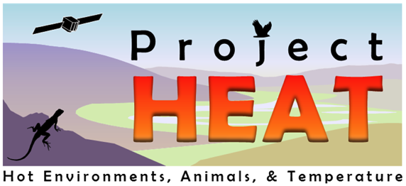
Specific objectives:
To increase interest in STEM topics among disadvantaged college-bound youth by engaging them in learner-led inquiry-based activities integrating micrometeorology, ornithology, and NASA imagery.
Characterize high temperature extremes at relevant scales using remote sensing,

Slide 9
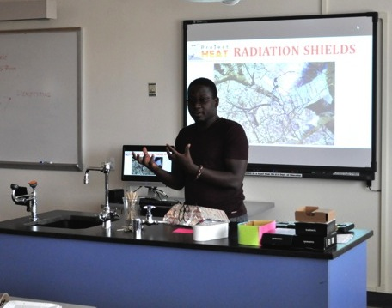
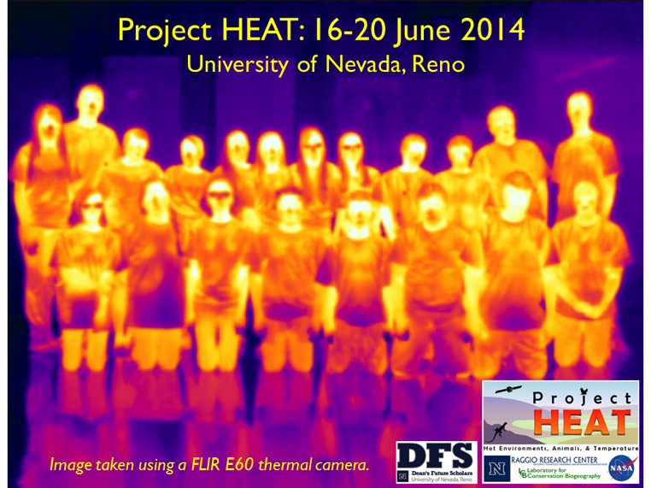
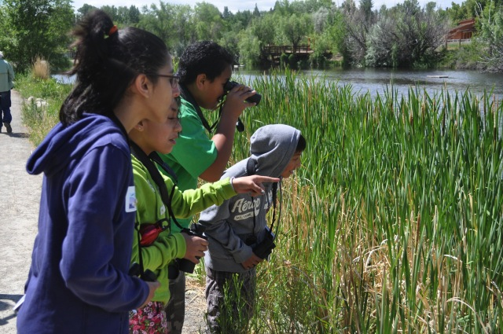
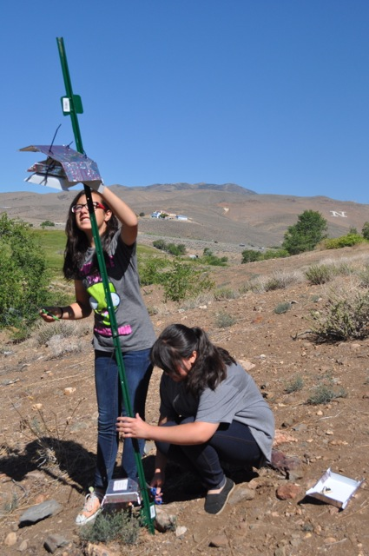
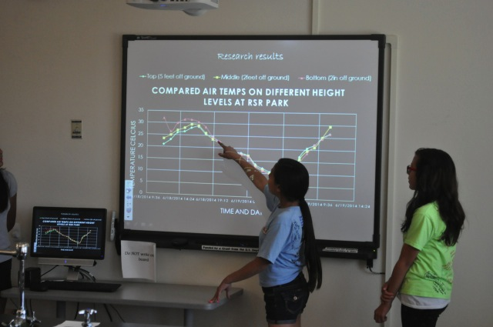
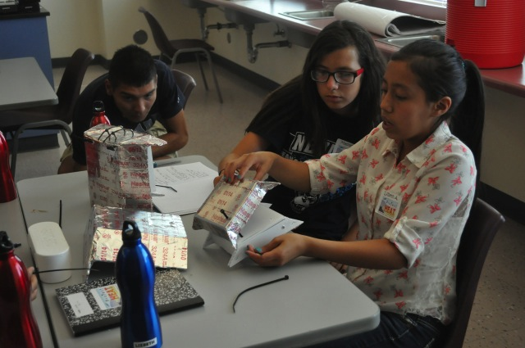
Specific objectives:
To increase interest in STEM topics among disadvantaged college-bound youth by engaging them in learner-led inquiry-based activities integrating micrometeorology, ornithology, and NASA imagery.
Characterize high temperature extremes at relevant scales using remote sensing,

Slide 10
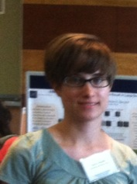
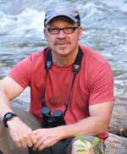
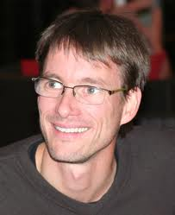
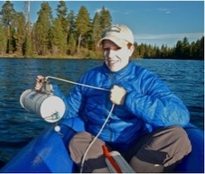
Project team & some collaborators
Denis Mutiibwa
Blair Wolf
U. New Mexico
Sonia Heckler
Markus Neteler,
Fondazione Edmund Mach
Eric Waller
Giancarlo Sadoti
Anna Pidgeon
U. Wisconsin-Madison
John Mejia
Desert Research Inst.
Jacque Ewing-Taylor
Kerry Howard
Notes:
Make this graphical rather than linear.

Slide 11
Avian dehydration risk (with Blair Wolf, U. New Mexico)
Q1
What are rates of evaporative water loss (EWL) for different species across range of temperatures?
How frequently, over what area, and at what intensity does dangerous dehydration occur?
How does variation in body size influence the dynamics and spatial expression of dangerous dehydration?
How will a warmer climate affect frequency and intensity of dangerous dehydration?
Q2
Q3
Q4

Slide 12
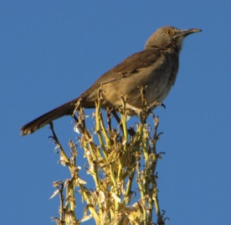
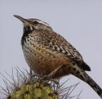
How do EWL rates vary across species and temperature?
Q1
Midsummer field captures in near Tucson, AZ
Flow-through respirometry
LEGO
nps.gov
CAWR
CBTH
nps.gov
nps.gov
Body mass
Body mass
Albright et al. in prep

Slide 13
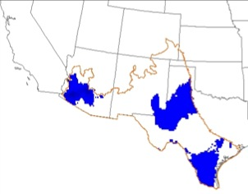
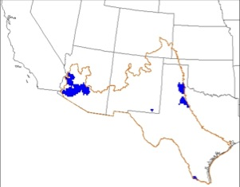
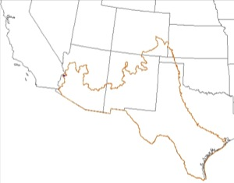
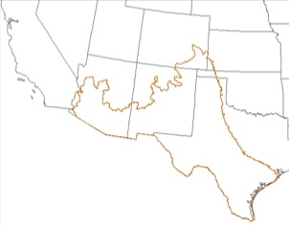
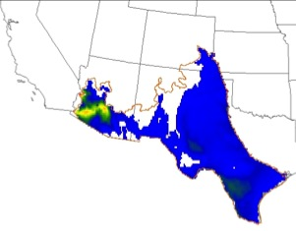
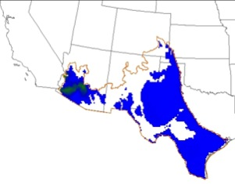
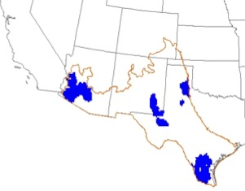
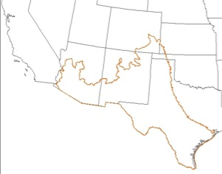
How frequently, over what area, and at what intensity does dangerous dehydration occur?
Q2
Weather: NLDAS-2
≤ 5hrs
≤ 4hrs
≤ 3hrs
≤ 2hrs
Current
(1980-2012)
Curve-billed thrasher (71.0 g)
Future
(2100)
Albright et al. in prep

Slide 14
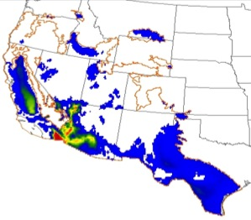
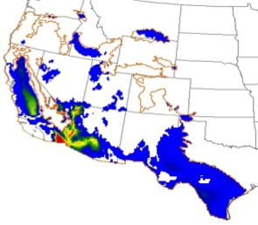
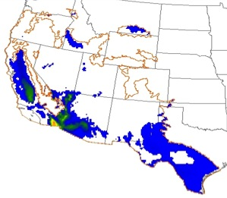
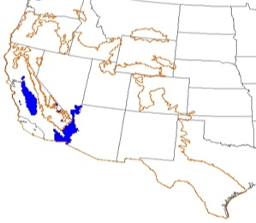
How does body size affect dynamics and spatial expression of dangerous dehydration?
Q2
Q3
Weather: NLDAS-2
≤ 5hrs
≤ 4hrs
≤ 3hrs
≤ 2hrs
Current
(1980-2012)
Curve-billed thrasher (71.0 g)
Current
(1980-2012)
Lesser goldfinch (9.7 g)
Future
(2100)
Albright et al. in prep

Slide 15
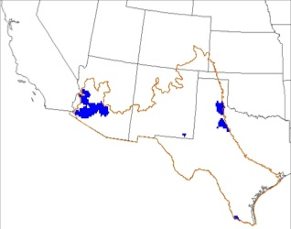
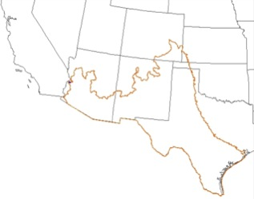
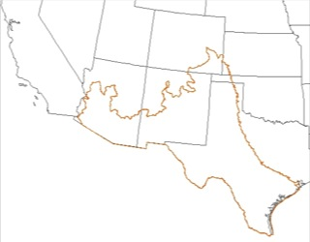
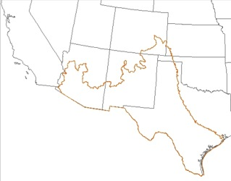
How will a warmer climate affect frequency and intensity of dangerous dehydration?
Q4
Weather: NLDAS-2, 4° C warming
≤ 5hrs
≤ 4hrs
≤ 3hrs
≤ 2hrs
Curve-billed thrasher (71.0 g)
Current
(1980-2012)
Future
(2100)
Albright et al. in prep

Slide 16
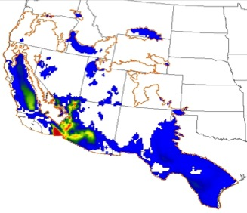
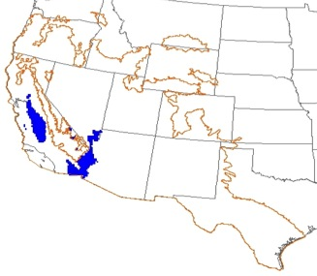
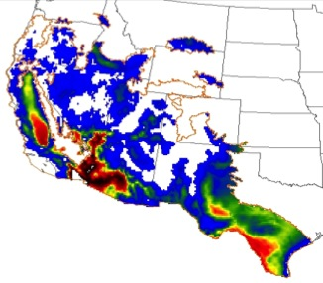
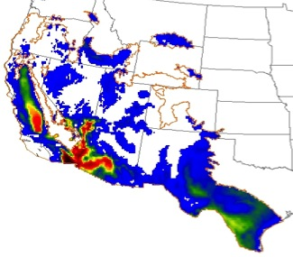
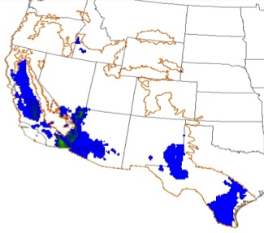
How will a warmer climate affect frequency and intensity of dangerous dehydration?
Q4
Weather: NLDAS-2, 4° C warming
≤ 5hrs
≤ 4hrs
≤ 3hrs
≤ 2hrs
Lesser goldfinch (9.7 g)
Current
(1980-2012)
Future
(2100)
Albright et al. in prep

Slide 17
Microclimatic refugia
How do vertical stratum and vegetation microsite modify environmental temperatures?

Slide 18
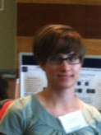
Effects on maximum temperature
Sonia Heckler

Slide 19
Dehydrating degree-hours
42°C
3
6
41°C
1
2
4
5
40°C
hours

Slide 20
Effects on dehydrating degree-hours

Slide 21
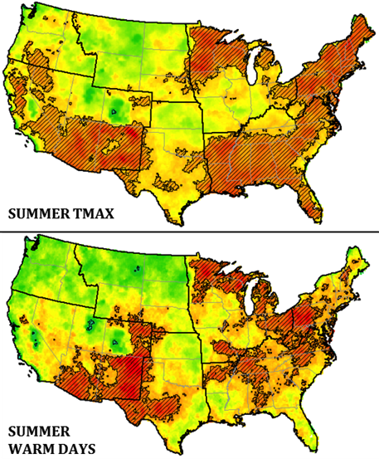
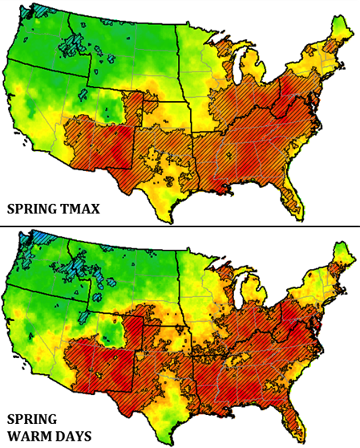
How are extreme hot days changing?
Mutiibwa et al. in review
Data: NLDAS-2

Slide 22
How are extreme hot days changing?
Mutiibwa et al. in review
Data: NLDAS-2

Slide 23
Fine resolution temperature modeling, Snake Range, NV (Vitale et al, in prep.)

Slide 24
Some perspective:

Slide 25
Desert Birds in a Warming World: Some next steps
Integrate microclimates into spatial physiological models
Improve gridded weather data (LST, other gridded products)
Confront models with observational avian data

Slide 26
Acknowledgements
Funding: NASA New Investigator in Earth Science NNX13AB65G, NASA Biodiversity Program, NSF ESPCoR EPS- 0814372, Great Basin Landscape Conservation Cooperative
UNR: G. Sadoti, A. Vitale, D. Mutiibwa, E. Waller, S. Heckler, K. Howard, J. Ewing-Taylor
Some collaborators: B. Wolf, A. Pidgeon, M. Neteler, E. Beever, J. Mejia
Field access: BLM, Long Now Foundation, Great Basin National Park, Kofa National Wildlife Refuge, and more…
http://wolfweb.unr.edu/~talbright/LCB/
talbright@unr.edu
@AlbrightLCB
[T. Albright]

